Slide 1

Breast Cancer Detection
Supervised by: Dr. Amal Aboutabl

Slide 2
Outline
Introduction
Problem Statement
Dataset
Proposed Solution
Mobile Application
Limitations
Conclusions & Future Work

Slide 3
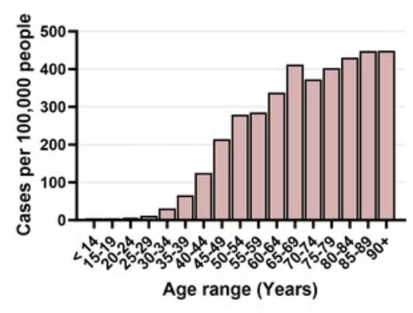
Introduction
Breast cancer is one of the most common and life-threatening diseases among women worldwide.
The incidence of breast cancer is rising by around 3% per year, as populations in many countries are getting older.
At age 40: Lifetime risk is approximately 1.5%.
This project presents an AI-powered mobile application for breast cancer detection and monitoring through mammogram image analysis.
At age 50: Lifetime risk rises to around 3%.
At age 70: Risk increases to more than 4%.

Slide 4
Outline
Introduction
Problem Statement
Dataset
Proposed Solution
Mobile Application
Limitations
Conclusions & Future Work

Slide 5
Problem Statement
Late Diagnosis: A leading cause of high breast cancer mortality, especially in low-resource settings.
Limited Access: Shortage of expert radiologists and diagnostic tools in many regions.
Current Methods: Traditional screening is time-consuming, costly, and not always accessible.
Need for Innovation: There's a strong demand for an affordable, accurate, and accessible early detection tool.
Proposed Solution: Develop an AI-based mobile platform to assist with early detection and monitoring via mammogram image analysis.

Slide 6
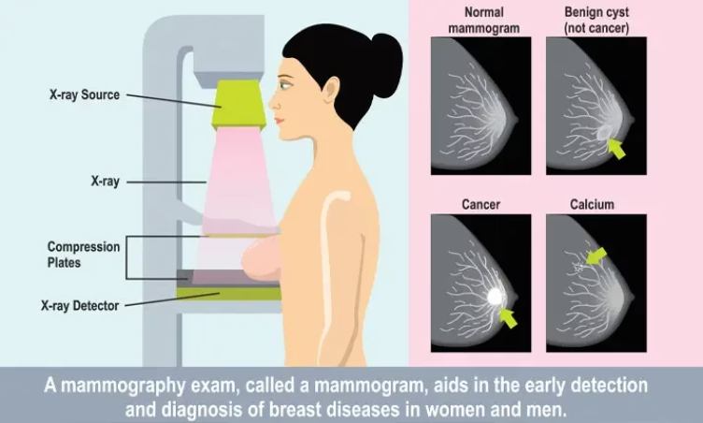
Mammogram
The most common screening test for breast cancer is low-dose X-ray imaging of the breast
Tumors can appear unusually dense within the breast, distort the shape of surrounding tissue, or cause small dense flecks called microcalcifications.
What if I have abnormal mammogram results?
Ultrasound – Uses sound waves to distinguish between solid masses and fluid-filled cysts.
MRI (Magnetic Resonance Imaging) – Provides highly detailed images.
Biopsy – Removes a small sample of tissue for lab testing to confirm if cancer is present.

Slide 7
Outline
Introduction
Problem Statement
Dataset
Proposed Solution
Mobile Application
Limitations
Conclusions & Future Work

Slide 8
Dataset
Comparison
Mammogram Mastery A Robust Dataset
CBIS-DDSM Dataset
Images
10,430
10,239
Cropped images
Types of Image
Augmented Cancer & Non-Cancer Mammogram Images
ROI mask images
Full mammogram images
Trained Model
Simple Model
Detailed Report Model

Slide 9
Outline
Introduction
Problem Statement
Dataset
Proposed Solution
Mobile Application
Limitations
Conclusions & Future Work

Slide 10
Proposed Solution
Transfer learning was applied uniformly across all models using pre-trained weights from the ImageNet dataset.
Trained Models:
InceptionV3
ResNet50
DenseNet
Xception

Slide 11
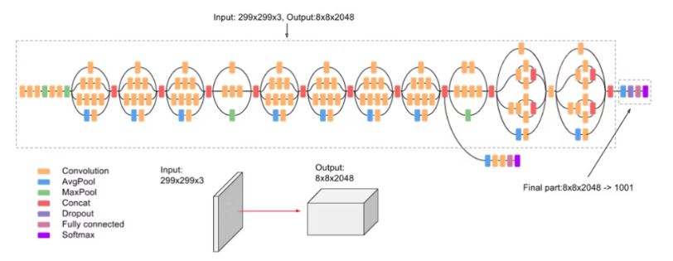
InceptionV3
InceptionV3 is a 42-layer deep CNN widely used for image classification on the ImageNet dataset. It can classify images into 1,000 categories, ranging from electronic devices to animals. The model processes input images of size 299×299 pixels and incorporates diverse components such as convolutions, pooling layers, concatenations, dropouts, and fully connected layers. It uses batch normalization throughout to stabilize training and employs Softmax for loss calculation. The architecture balances performance and efficiency through a combination of symmetric and asymmetric modules.

Slide 12
Proposed Solution
Transfer learning was applied uniformly across all models using pre-trained weights from the ImageNet dataset.
Trained Models:
InceptionV3
ResNet50
DenseNet
Xception

Slide 13
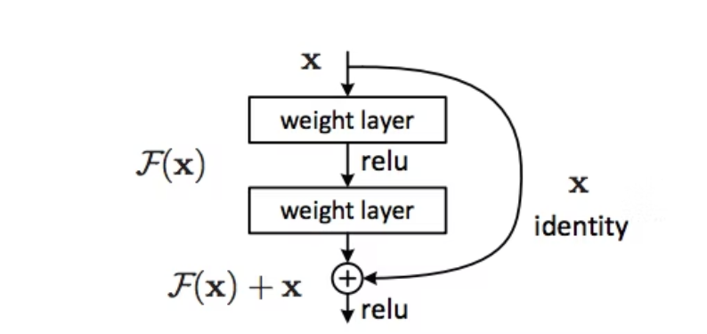
ResNet50
ResNet50 is a 50-layer deep convolutional neural network that uses residual blocks with skip connections to simplify the training of deep networks. These skip connections allow the model to learn residual functions instead of full mappings, helping to address vanishing gradient problems.
The core idea is represented as F(x) + x, where F(x) is the output of the convolutional layers and x is the input.

Slide 14
Proposed Solution
Transfer learning was applied uniformly across all models using pre-trained weights from the ImageNet dataset.
Trained Models:
InceptionV3
ResNet50
DenseNet
Xception

Slide 15
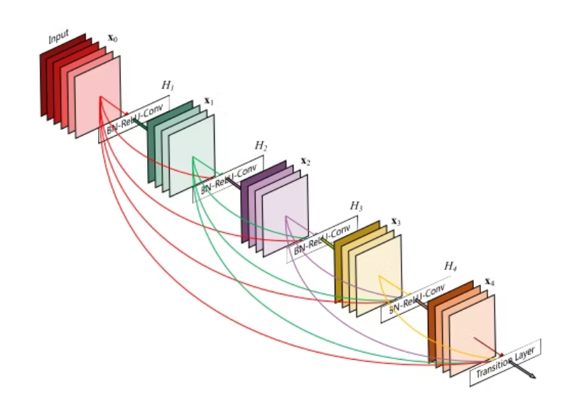
DenseNet
DenseNet (Densely Connected Convolutional Network) improves feature reuse and gradient flow by connecting each layer to all preceding layers within a dense block. Unlike traditional CNNs, where layers connect sequentially, DenseNet allows L(L+1)/2 direct connections for L layers. Each layer receives inputs from all previous layers and passes its output to all subsequent layers, enhancing training efficiency and reducing the vanishing gradient issue.

Slide 16
Proposed Solution
Transfer learning was applied uniformly across all models using pre-trained weights from the ImageNet dataset.
Trained Models:
InceptionV3
ResNet50
DenseNet
Xception

Slide 17
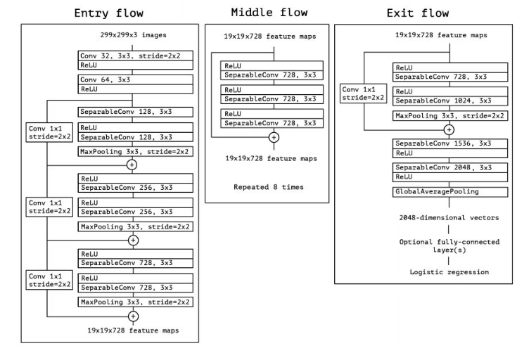
Xception
Xception, proposed by François Chollet, the creator of Keras, is a deep convolutional neural network with 36 ConvNet layers used for feature extraction. These layers are grouped into 14 modules, most of which include linear residual connections to enhance training efficiency. Xception builds on the Inception architecture by fully replacing standard Inception modules with depthwise separable convolutions, offering a more efficient and powerful model.

Slide 18
Simple Model
was trained on the dataset to classify images as either cancerous or non-cancerous. The model outputs a prediction along with a confidence score, indicating the probability of the image belonging to each class.

Slide 19

Simple Model
Training Configuration
Input Size: 100 × 100 pixels, 3 RGB channels
Training: 100 epochs, batch size of 32
Classification Head:
Fully connected layers with ReLU activation
Dropout for regularization
Batch normalization for training stability
Output Layer:
Softmax activation for multi-class classification
Target classes: Cancer and Non-cancer

Slide 20
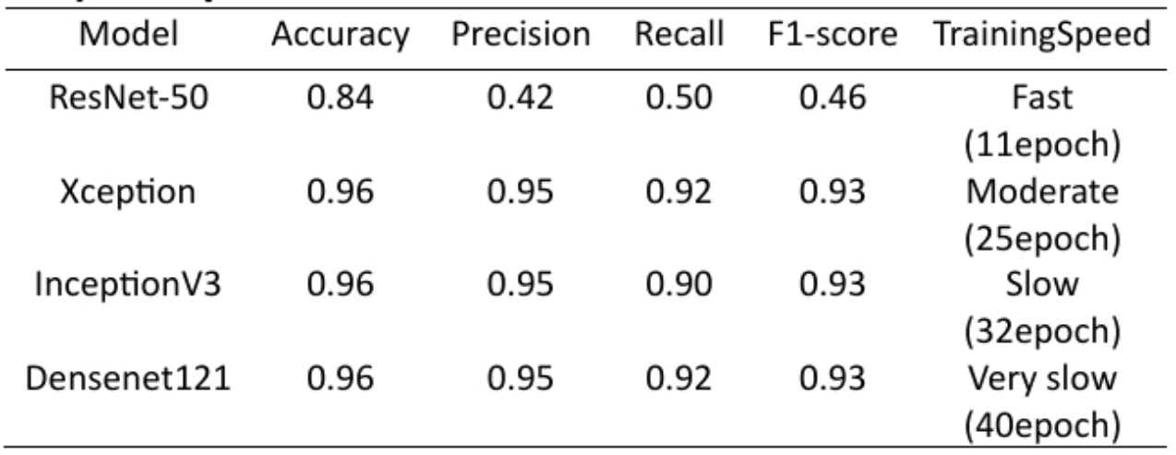
Simple Model
Among these, the Xception model was selected due to its superior accuracy.

Slide 21
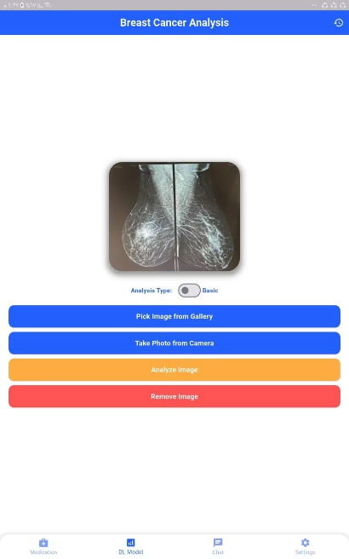
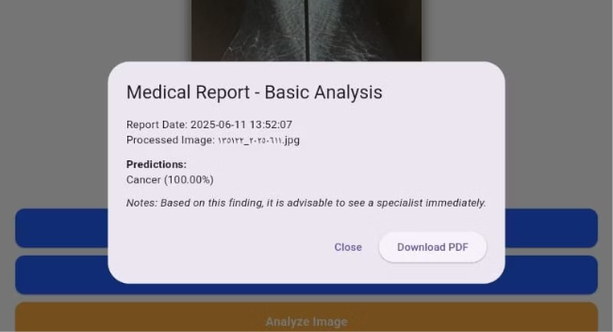
Simple Model
AI Simple Model analyze The image and Output Cancer with confidence percentage
User Put Mammogram image

Slide 22
Detailed Model: Report Diagnosis

Slide 23
Detailed Model : Data Preprocessing
1. Dataset Consolidation
2. Image Path Mapping
3. Missing Value Imputation
All four preprocessed tables were concatenated column-wise into a unified dataset to maintain a consistent schema across all image records.
Image file paths were updated to reflect their new locations within the project directory, ensuring correct access during model training.
Remaining missing values were handled using:
Backward Fill (bfill): Replaces missing entries with the next valid value.
Forward Fill (ffill): Replaces missing entries with the previous valid value.

Slide 24
Detailed Model
Output Structure: Multi-task classification using 10 distinct softmax output layers:
Training Configuration:
Input Size : 224 × 224 pixels, 3 RGB channels
Mass Shape
Classification Head:
Mass Margins
Calcification Type
Global Average Pooling
Calcification Distribution
Fully connected Dense layers with ReLU activation
Pathology
Dropout (rates: 0.5 and 0.3) for regularization
Breast Density
Batch Normalization for training stability
Left or Right Breast
Image View
Abnormality ID
Abnormality Type

Slide 25
Comparison
Compare
DenseNet
InceptionV3
Xception
image_view_accuracy
0.9444
0.8923
0.9105
abnormality_id_accuracy
0.8499
0.8490
0.8512
calc_distribution_accuracy
0.8046
0.8024
0.7998
left_or_right_breast_accuracy
0.6560
0.7310
0.7974
calc_type_accuracy
0.6724
0.6720
0.6701

Slide 26
Comparison
Compare
DenseNet
InceptionV3
Xception
breast_density_accuracy
0.6610
0.6488
0.6397
mass_margins_accuracy
0.6605
0.6935
0.6935
abnormality_type_accuracy
0.5659
0.5255
0.5984
mass_shape_accuracy
0.5373
0.5678
0.5724
pathology_accuracy
0.6814
0.6203
0.6217

Slide 27
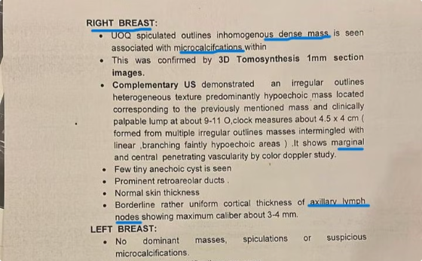
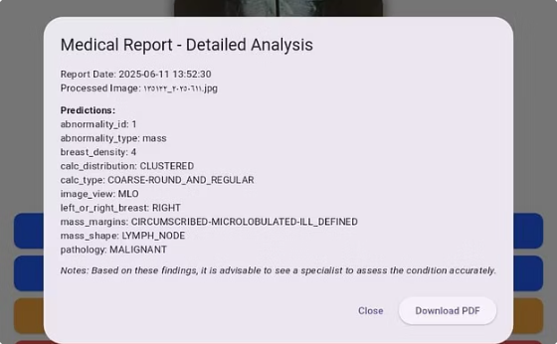
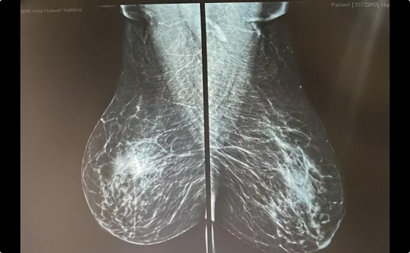
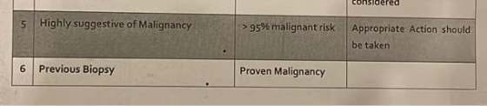
Comparison between reports
abnormality in the RIGHT BREAST.
Pathology: MALIGNANT
Abnormality_type: mass
abnormality in the RIGHT BREAST.
Calcifications: "Clustered, coarse-round"
highly suggestive of malignancy
Lymph Node Involvement:"Mass_shape: lymph_node"
UOQ palpable malignant-looking mass
Calcifications: "Microcalcifications with dense mass"
Lymph Node Involvement:"Suspicious axillary nodes" + "Borderline cortical thickness"

Slide 28
Outline
Introduction
Problem Statement
Dataset
Proposed Solution
Mobile Application
Limitations
Conclusions & Future Work

Slide 29

Mobile Application
Why Choose Flutter Application?
Flutter is a powerful open-source UI software development kit created by Google. It is used to develop cross-platform applications for Android, iOS, Linux, macOS, Windows, Google Fuchsia, and the web from a single codebase.

Slide 30

Key Features
Single Codebase
Hot Reload
Rich, Customizable Widgets
High Performance
Access to Native Features
Open-Source and Strong Community

Slide 31
What Is Flask
Endpoints:
Simple Prediction:
Purpose : Serve trained deep learning models via a Flask RESTful API, enabling mobile app integration.
Accepts image via POST
Returns Cancer/Non-Cancer + confidence score
Detailed Prediction:
Returns multiple attributes (e.g., pathology, mass shape, calc type)
Provides diagnostic report with timestamp

Slide 32
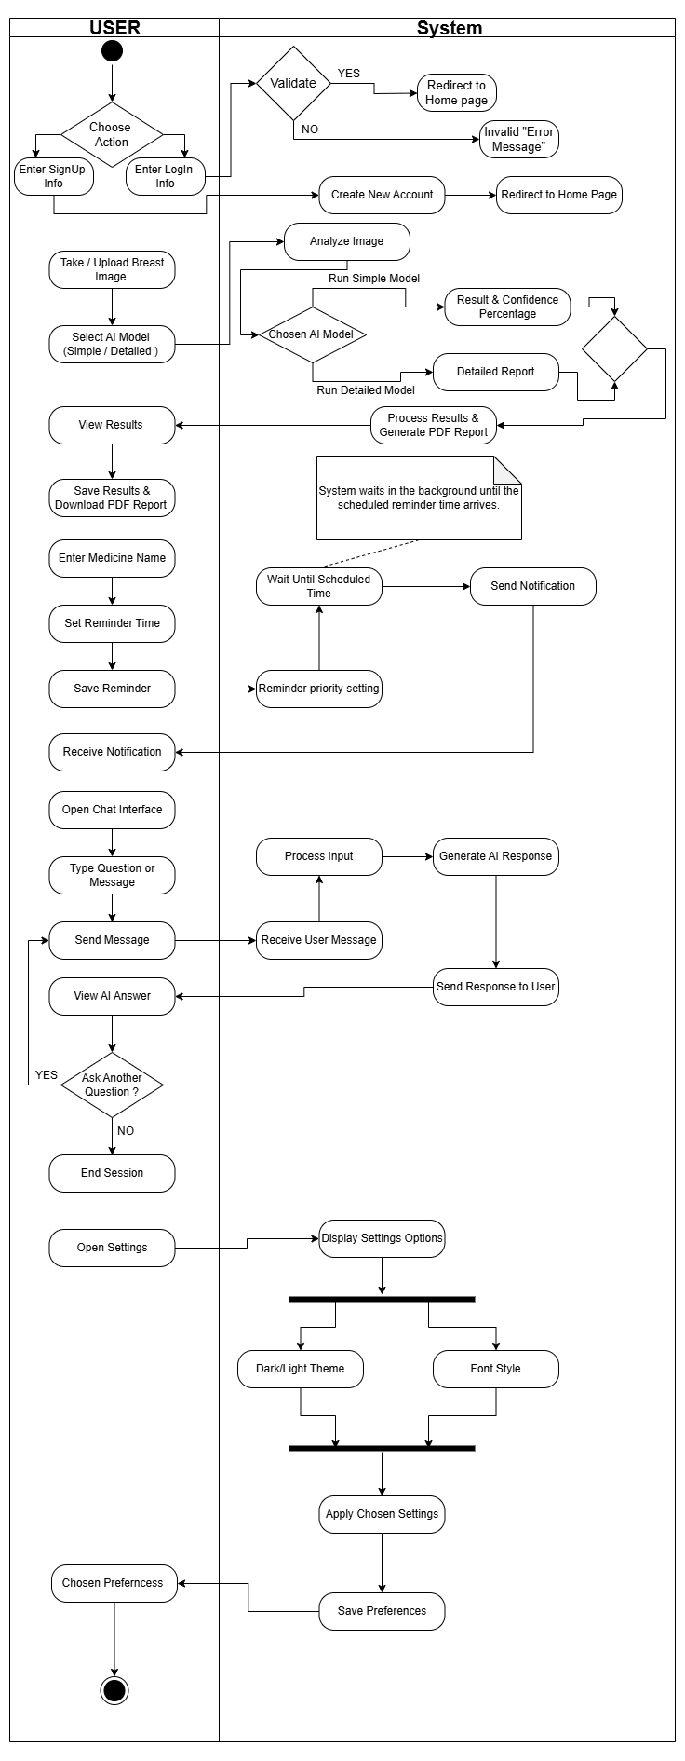
Activity
Diagram

Slide 33

Demo

Slide 34
Outline
Introduction
Problem Statement
Dataset
Proposed Solution
Mobile Application
Limitations
Conclusions & Future Work

Slide 35
Limitations
Limited Dataset Usage: We utilized only a small portion of the available dataset — 6 GB out of 163 GB — due to storage and processing constraints.
Resource Constraints: Our experiments were conducted with limited computational resources, which impacted the scale and speed of our work.
Need for Real-World Data: We aim to collaborate with hospitals in the future to access real-world medical data for more robust and clinically relevant results.

Slide 36
Outline
Introduction
Problem Statement
Dataset
Proposed Solution
Mobile Application
Limitations
Conclusions & Future Work

Slide 37
Conclusion

Slide 38
Conclusion
A simple classification model quickly identifies whether a medical image indicates cancer or not.
A more detailed diagnostic model provides comprehensive reports, including lesion characteristics and diagnostic insights.
Both models are seamlessly integrated into a mobile application.
The app also includes practical features to support patient care, such as a medicine reminder alarm, helping users stay on track with treatment and follow-up.

Slide 39
Future Work

Slide 40
Future Work
1
Multi-Cancer Detection
2
Specialist & Clinic Integration
Extend detection of cancers to include::
Lung, Skin, Bone and Colorectal cancers.
Book appointments with oncologists based on location and diagnostic results.
3
Patient Record Management
4
Multi-Modal Imaging for Enhanced Cancer Detection
Secure tracking of medical history and diagnostic reports.
diverse datasets and imaging modalities:
CT, MRI, PET, and Ultrasound.

Slide 41

Thanks!
Any Questions..?

